Slide 1

SMART INDIA HACKATHON 2026
Indigenous Atmospheric Infrasound Monitoring Platform
Problem Statement ID – SIH26144
Problem Statement Title - High Sensitivity Micro-Barometer Infrasound sensor
Theme- Smart Automation
PS Category- Hardware
Team ID- 155882
Team Name- SPADES

Slide 2
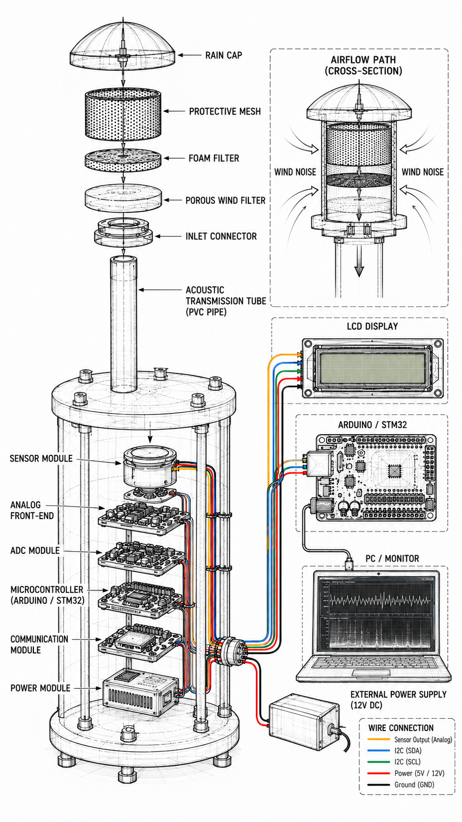
PROBLEM STATEMENT &
PROPOSED SOLUTION
SPADES
CHALLENGES
PROPOSED SOLUTIONS
Wind Turbulence
Multi-stage Passive Wind Suppression
Temperature Drift
Underground Environmental Enclosure + Temperature Compensation (Planned)
Weather Pressure Variations
Differential Pressure Equalization Network
Weak Infrasound Signals
MEMS Capacitive Sensor + Low Noise Amplifier
Analog Signal Integrity
Low-Noise Analog Front-End + 24-bit ADC Digitizer
Long-Term Pressure Stability
Long-Period Pressure Equalization Network
Event Identification
FFT-Based Signal Analysis
Calibration Requirement
Reference Calibration using Pressure Testing
Sensor Maintenance
Modular Cartridge Architecture
KEY INNOVATION
Differential Measurement
Pressure Equalization
Reference Calibration
STA/LTA Detection

Slide 3
TECHNICAL APPROACH
SPADES
System Workflow
Pneumatic front end
Electronics
Software
Atmospheric Inlet
Wind Noise Reduction Array
Acoustic Tube
Underground Enclosure
Differential Pressure Chamber
Long-Period Pressure Equalization Network
MEMS Capacitive Pressure Sensor
01
02
03
04
05
06
07
Low Noise Amplifier
24-bit ADC Digitizer
STM32 Controller
Filtering & FFT Analysis
STA/LTA Event Detection
Event Storage & Alerts
Real-Time Dashboard
08
09
10
11
12
13
14
Hardware
Software
Target Event Types
MEMS Capacitive Pressure Sensor
MEMS Diaphragm-Based Mechanical Transducer
Differential Pressure Chamber
Pressure Equalization Network
Wind Noise Reduction Module
STM32 + 24-bit ADC Digitizer
WiFi Telemetry
Embedded C on STM32
Butterworth IIR filtering
Temperature Compensation
Radix-2 FFT, Welch PSD
STA/LTA event detection
MQTT telemetry
Next.js + React (TypeScript)
HTML5 Canvas live charts
Explosion
Rocket Launch
Thunderstorm
Ambient Noise

Slide 4
FEASIBILITY AND VIABILITY
SPADES
TECHNICAL FEASIBILITY
CHALLENGE VS SOLUTION
TARGET PERFORMANCE
Challenge |  | Engineering Solution
Pressure Drift | → | Differential Pressure Equalization
Thermal Drift | → | Underground Environmental Enclosure
Long-Term Stability | → | Self-Calibration using Reference Pressure Testing
Maintenance | → | Plug-and-Replace Cartridge Design
FREQUENCY RANGE
Commercial Components Available
<20 Hz
Infrasound band
Standard PCB Manufacturing
0
0.1
1
10
100
Low Drift
Modular Design
Real-Time Monitoring
Real-Time Monitoring
VALIDATION & EVALUATION PLAN
✓
Low-Frequency Signal Detection
0.01–20 Hz Response
Scalable Architecture
✓
Frequency Response Testing
✓
Noise Floor Measurement
Modular Maintenance
Feasibility criteria met
5 / 5
✓
Sensitivity Estimation
✓
Stability Testing

Slide 5
IMPACT AND BENEFITS
SPADES
APPLICATIONS
Atmospheric Event Monitoring
Atmospheric anomaly detection
High-energy event monitoring
Geophysical Monitoring
Monitor atmospheric signatures of geophysical events
Support scientific research
Rocket & Aerospace Monitoring
Detect launch-generated infrasound
Support aerospace testing
Atmospheric & Volcanic Research
Monitor volcanic activity
Study atmospheric dynamics
Industrial Safety
Monitor large industrial events
Detect abnormal pressure disturbances
ATMOSPHERIC SIGNALS
Indigenous Infrasound Monitoring Platform
ACTIONABLE MONITORING INFORMATION
KEY BENEFITS
Sustainable Development
Technical Benefits
Economic Benefits
SDG
9
Industry, Innovation & Infrastructure
High-Sensitivity Infrasound Detection
Low-Noise Signal Conditioning & Digitization
Differential Pressure Measurement
Real-Time Monitoring & Analysis
Modular Maintenance Architecture
Reduced Lifecycle Servicing Cost
Commercially Available Components
Scalable Sensor Deployment
SDG
16
Peace, Justice & Strong Institutions
Environmental Benefits
Strategic Benefits
SUPPORTS
Atmanirbhar Bharat
Indigenous Strategic Technology Development
Low-Power Operation
Long-Term Field Deployment
Minimal Environmental Footprint
Supports Atmospheric Research
Atmospheric Event Intelligence
Strategic Monitoring Capability
Supports Strategic Monitoring Applications
Indigenous Monitoring Infrastructure

Slide 6
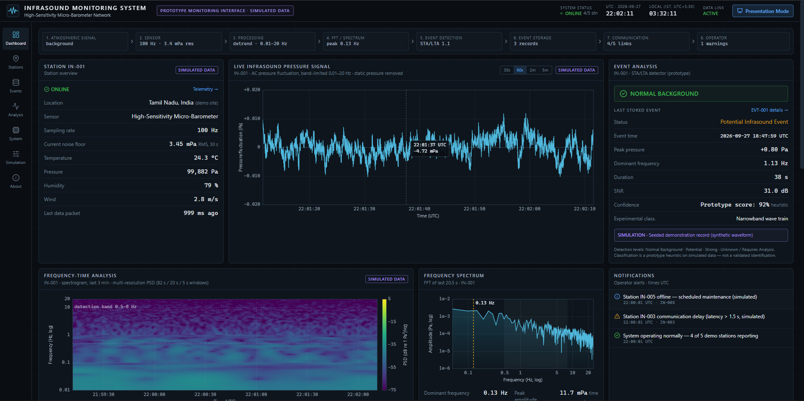
RESEARCH AND REFERENCES
SPADES
RESEARCH DRIVEN DESIGN
PROTOTYPE MONITORING DASHBOARD
CTBTO Infrasound Monitoring Architecture
Reference IMS station design for sensor and array layout
Source: CTBTO Website
Wind Noise Reduction Systems
Porous-hose and pipe-array filters to suppress wind noise
Source: Research Paper
Differential Pressure Measurement
Inlet vs. sealed reference volume, sensor reads the difference
Source: Academic Research
Pressure Equalization Networks
Slow leak path that removes daily barometric changes
Source: Academic Research
Low-Noise Atmospheric Sensing
Low-noise front end and signal-to-noise design
Source: Published Literature
DASHBOARD FEATURES
✓ Live Waveform Display
✓ FFT Spectrum Analysis
✓ Frequency-Time Spectrogram
Strategic Monitoring Applications
Explosion, launch and volcano monitoring use cases
Source: CTBTO / Research Literature
✓ STA/LTA Event Detection
✓ Event Logging & Alerts
✓ Station Health Monitoring
Developed Monitoring Portal: Micro-Barometer Dashboard

